Slide 1
Bike-Sharing Rental Demand Forecasting
Mustafa Abdel-Nasser & Zaid Mostafa

Slide 2
Agenda
Bike-Sharing
Our Objectives
Data Understanding and Cleaning
Descriptive Analysis
Predictive Analysis
Conclusion

Slide 3
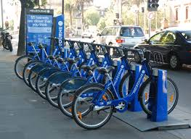
Bike-Sharing

Slide 4
Objectives
The project aims to help forecast the demand for the bike-sharing company based on the number of available attributes given in the data.

Slide 5
Data Understanding and Cleaning
Base Data Size: 731 Obs. Of 11 Variables.
Target Variable – Total Count of Bikes Rented
Data abstract: This dataset contains the daily count of rental bikes between years 2011 and 2012 from Capital bikeshare system, Washington D.C., USA with the corresponding weather and seasonal information

Slide 6
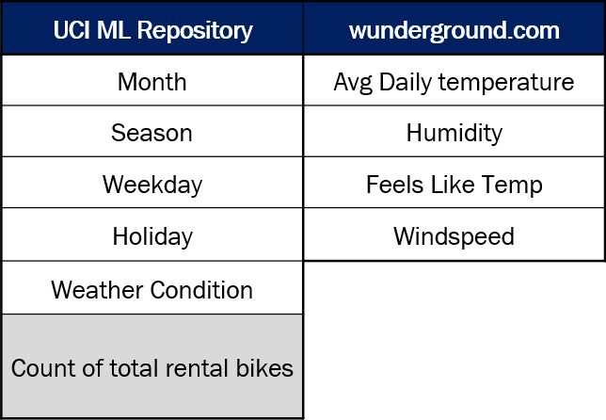
Data Understanding and Cleaning

Slide 7
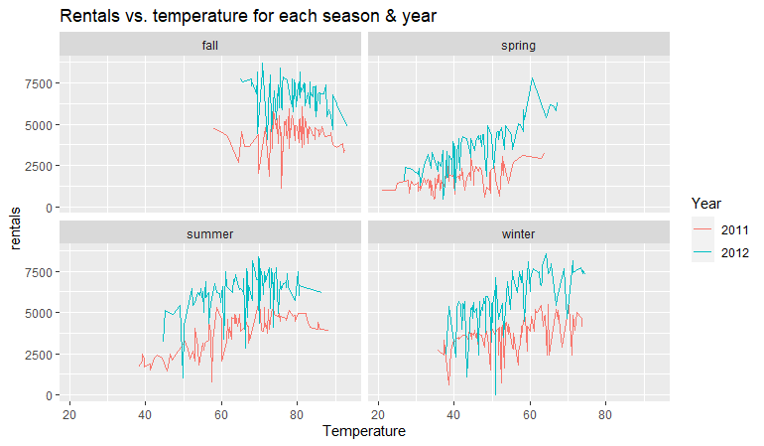
Descriptive Analysis
Total rentals vs. the temperature
categorized by year and season

Slide 8
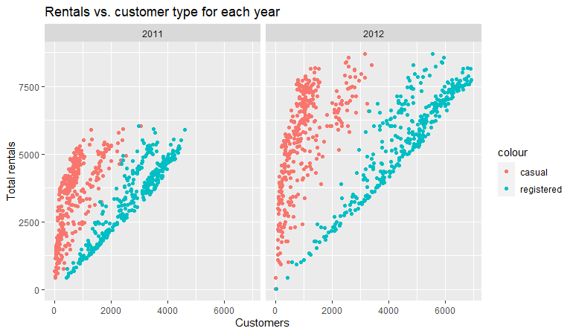
Descriptive Analysis
Registered ridership is high
in comparison to the casual ridership.
There is a separation between the data
points for each type

Slide 9
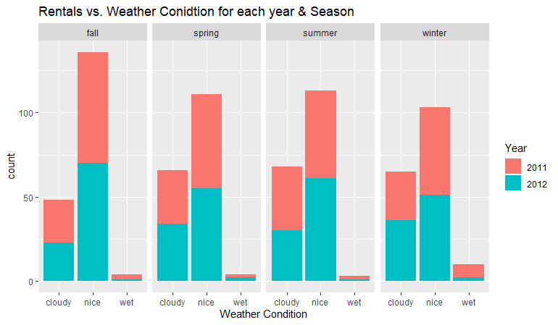
Descriptive Analysis
Number of rentals increase when the weather
condition is “nice” in all four seasons of the year

Slide 10
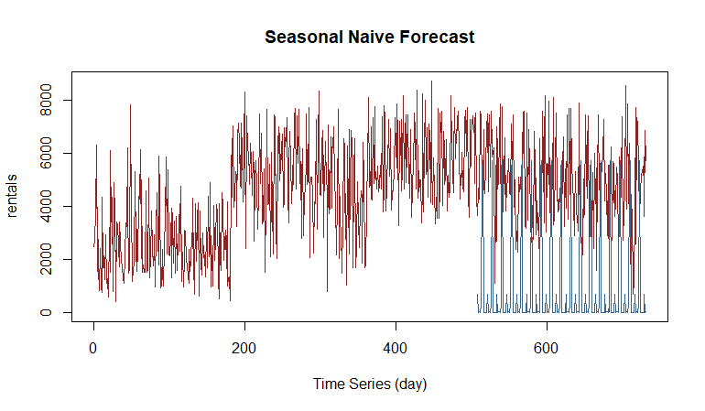
Predictive Analysis
Seasonal naive technique
The accuracy of this prediction is low
R2 = 51% and
MAPE = 10608.

Slide 11
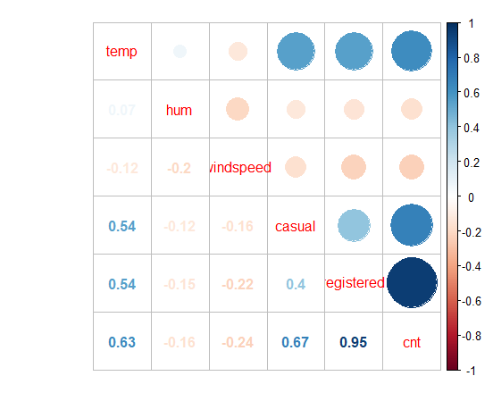
Predictive Analysis
Multilinear regression model
Cnt with (registered, casual, temp)
high positive correlation

Slide 12
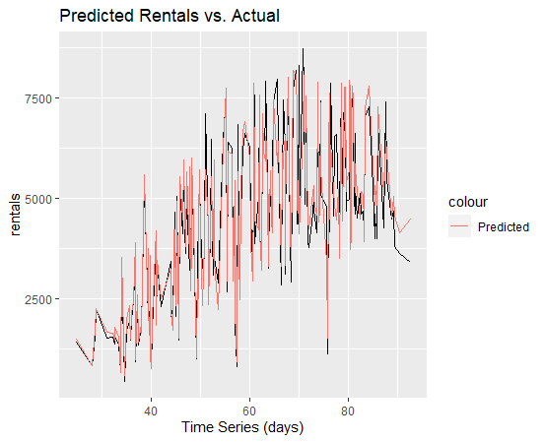
Predictive Analysis
Multilinear regression Model
Accuracy is high
R2 = 91%
MAPE = 634

Slide 13
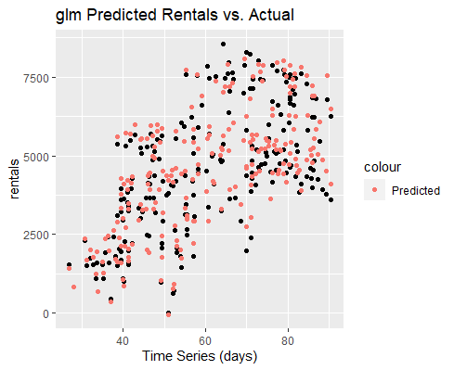
Predictive Analysis
Logistic Regression model
Accuracy is acceptable
R2 = 81%

Slide 14
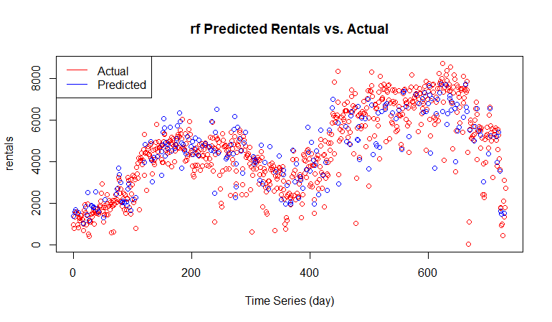
Predictive Analysis
Random Forest model
Accuracy is high
R2 = 89%
MAPE = 701

Slide 15
Predictive Analysis
For a given set of weather conditions and a specific type of day, can you figure the probability the day is good for biking?

Slide 16
Conclusion
The mean temperatures vary significantly over the seasons
Figures of total bike rents changes depending on weather condition and vary regarding their means. The most significant pairwise mean difference is typical for spring, summer, and fall seasons, while the most insignificant for winter.

Slide 17
Conclusion
Weather condition and total number of bike rentals also seemed to be significantly correlated. The two popular weather conditions for bike rentals are nice and Cloudy weather.
There exists a significant correlation between the number of total bike rentals and (casual, registered, temp) variables.
To sum it up, we can say, that the total amount of bike rentals is dependent on the weather and also on the users’ status (registered vs. casual).

